Slide 1

finally

Slide 2

Recap
What and why code review
Mike’s principles - “Just” review the code - Clarity, friendliness - Positivity, humility - Make your feedback acceptable by the submitter
Be ready to handle and accept failure

Slide 3

The WWW principle
Win for the project: better codebase, homogeneity
Win for the submitter: improve skills, knowledge
Win for the reviewer: better overview of codebase, learn new things

Slide 4
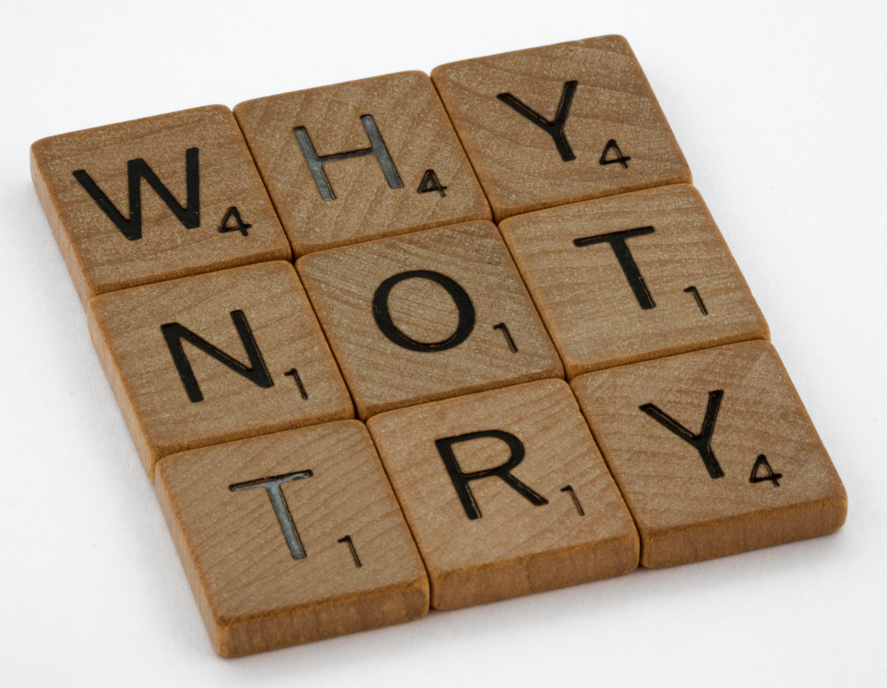

The Core Collaborators Team
https://community.umbraco.com/community-teams/the-core-collaborators/
Contribute!!
We’re friendly

Slide 5
Resources & References
https://our.umbraco.com/
https://skrift.io/
https://github.com/umbraco/Umbraco-CMS
https://community.umbraco.com/community-teams/the-accessibility-team/
pictures: pexels.com – Andrea Piacquadio, cottonbro & Brett Jordan

Slide 6


Feedback & contact
Michaël Latouche
@ michael@latouche.be @michaellatouche michaellatouche

Slide 7

Thank You
Thank You

